Slide 1

Fake News Detection Project
Presented By: Safiya Firdose Khan

Slide 2
Overview:
In this particular presentation we will be looking on:
How to analyze the dataset of Fake News Project.
What are the EDA steps in cleaning the dataset.
Overall analysis of the problem.
Model building
Predictingwhether the news is fake or true.

Slide 3
Introduction:
Fake news is a form of news consisting of deliberate disinformation or hoaxes spread via traditional news media or online social media. Such news items may contain false and/or exaggerated claims, and may end up being vitalized by algorithms, and users may end up in a filter bubble.
Fake news is not a recent concept, but it is a commonly occurring phenomenon in current times. .With the widespread dissemination of information via digital media platforms, it is of utmost importance for individuals and societies to be able to judge the credibility of it.

Slide 4
Business Problem:
The authenticity of Information has become a longstanding issue affecting businesses and society, both for printed and digital media. On social networks, the reach and effects of information spread occur at such a fast pace and so amplified that distorted, inaccurate, or false information acquires a tremendous potential to cause real-world impacts, within minutes, for millions of users.
The goal of this project is to use natural language processing techniques to automate stance detection, since it is not practical for humans to fact check every piece of information produced by the media.

Slide 5
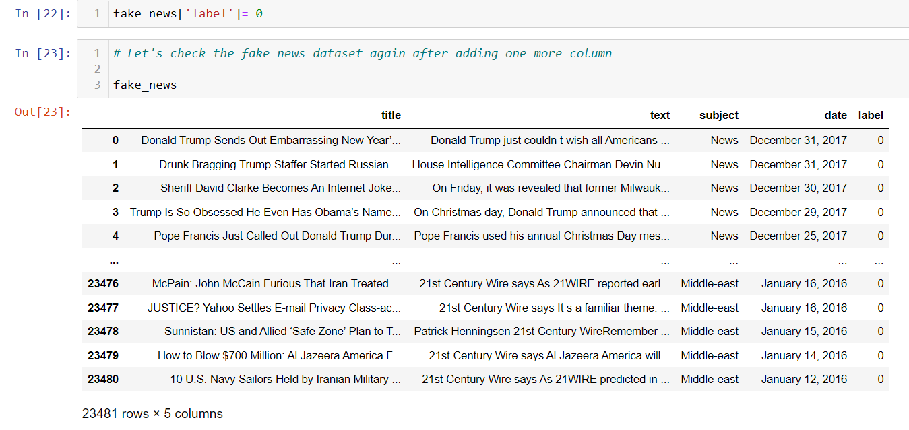
Exploratory Data Analysis:
As a first step, I have imported required libraries and I have imported the two datasets, one for fake news and one for true news, which are in csv format.
As there is no label column present, I have inserted the label column zero for fake news and one for true news.

Slide 6
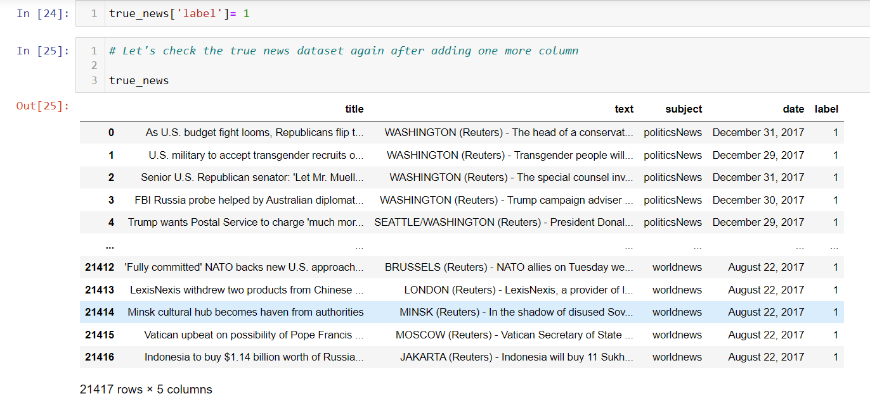

Slide 7
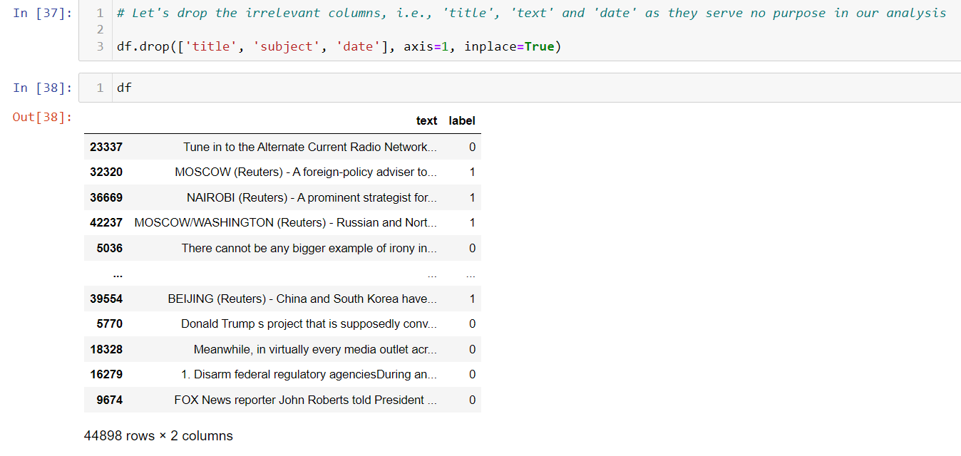
Exploratory Data Analysis:
Then, I performed the statistical analysis on the dataset, like checking shape, nunique, info, etc.
Then, I checked the null values in both the datasets, and found out that there are no null values present in both the datasets.
I have dropped the irrelevant columns, as they serve no purpose in our analysis.

Slide 8
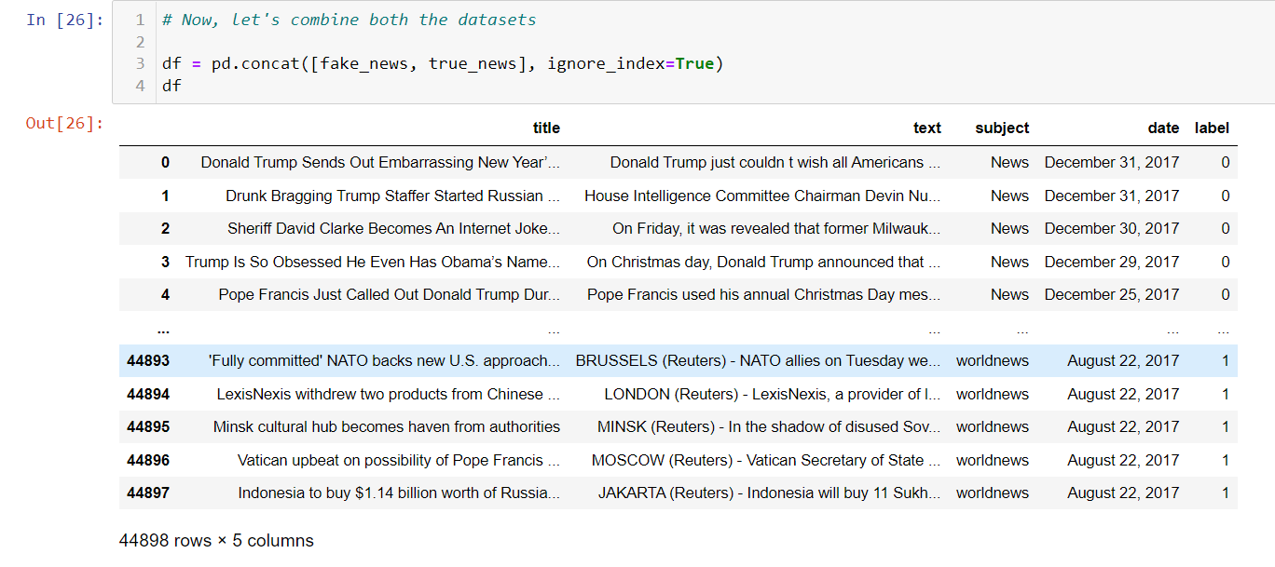
Then, I have combined both the datasets using pandas built-in function.

Slide 9
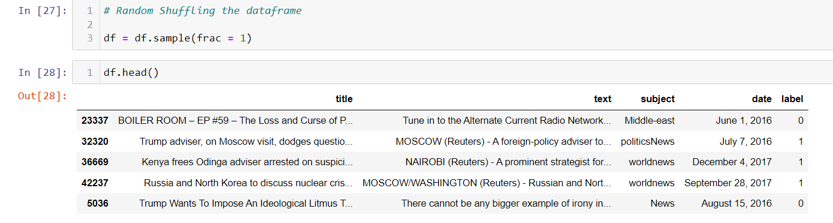
Then, I have randomly shuffled the dataframe.

Slide 10
Exploratory Data Analysis:
Cleaning the raw data involves the deletion of words or special characters that do not add meaning to the text.
Important cleaning steps are as follows:
1. Lowering case
2. Handling of special characters
3. Removal of stopwords
4. Converting words to the most suitable base form by using lemmatization.

Slide 11
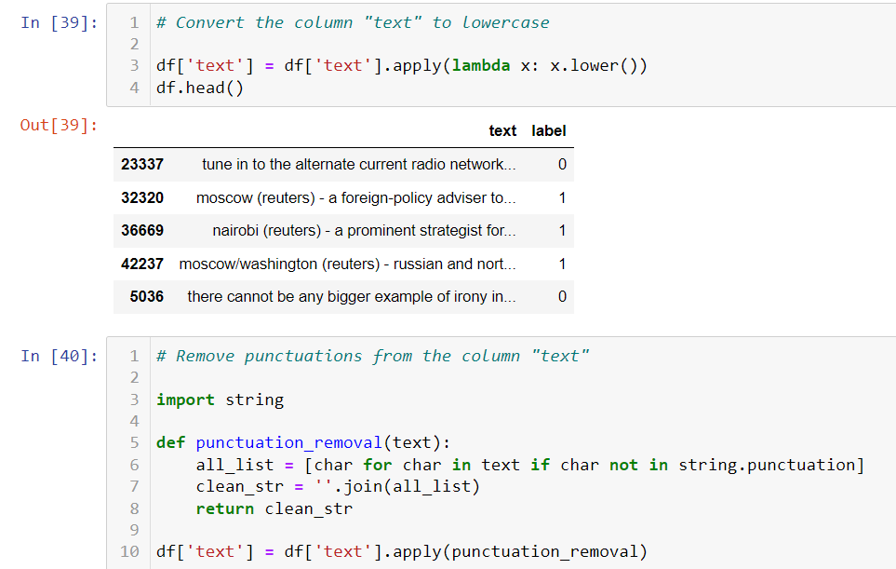

Slide 12
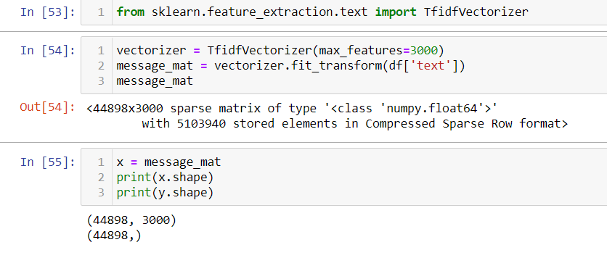
Then, I have converted text to vectors using TfidfVectorizer.

Slide 13
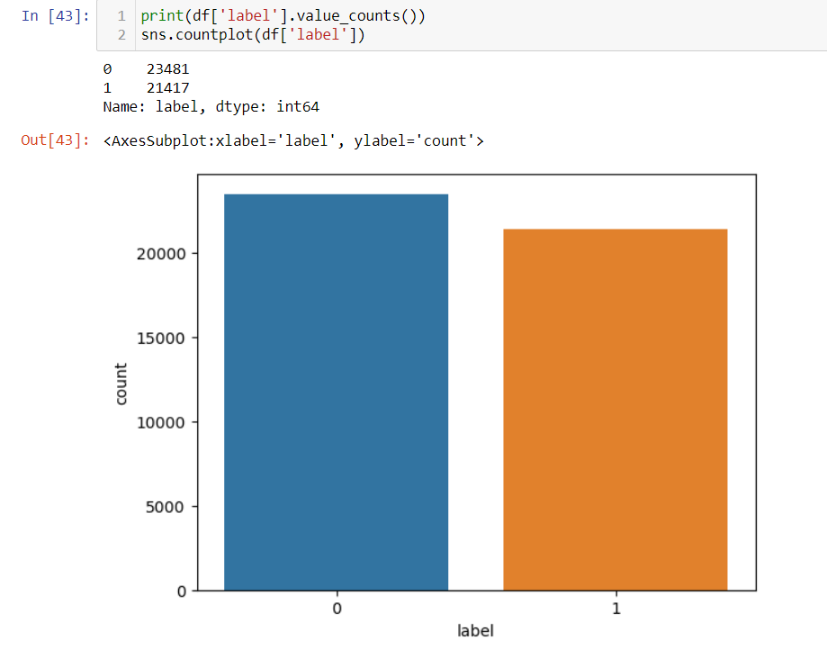
Visualizations:

Slide 14
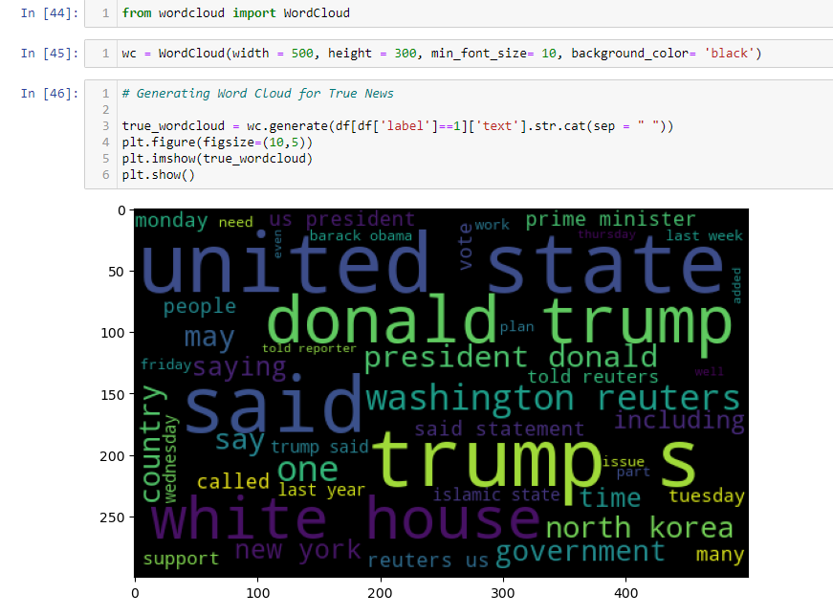

Slide 15
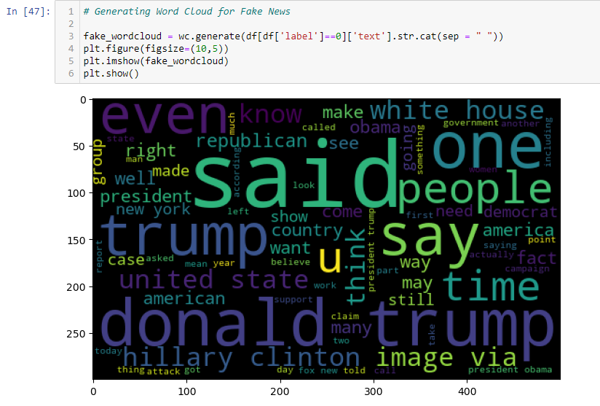

Slide 16
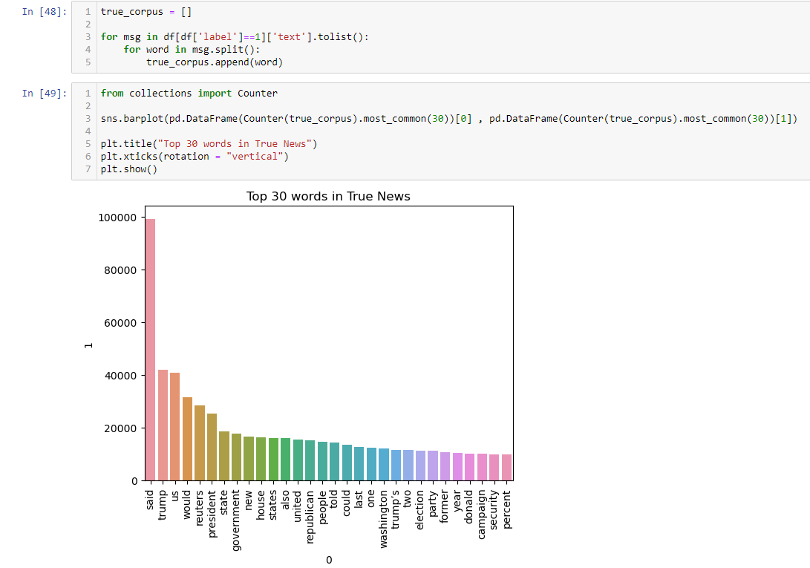

Slide 17
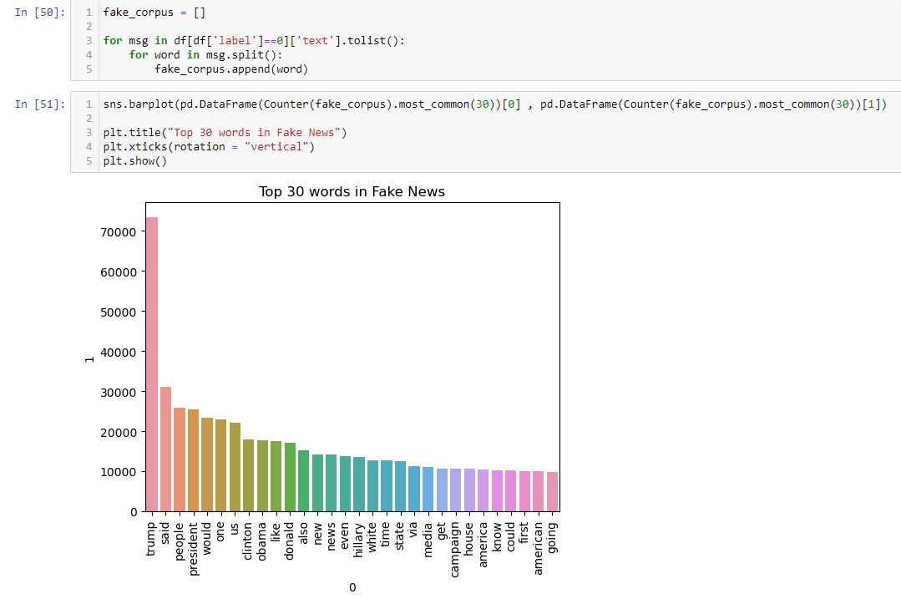

Slide 18
Model Building:
Since “label” is my target variable and it is discrete in nature, so this particular problem is a classification problem. I have used 10 different classification algorithms to build my model. By looking at the accuracy score and Cross Validation score, I found that Light Gradient Boosting Machine Classifier is the best model.
Below is the list of classification algorithms, that I have used in my project.
Logistic Regression
Random Forest Classifier
Decision Tree Classifier
Linear Support Vector Machine Classifier
XGB Classifier
Gradient Boosting Classifier
Stochastic Gradient Descent Classifier
Bernoulli Naive Bayes Classifier
Multinomial Naive Bayes Classifier
Light Gradient Boosting Machine Classifier

Slide 19
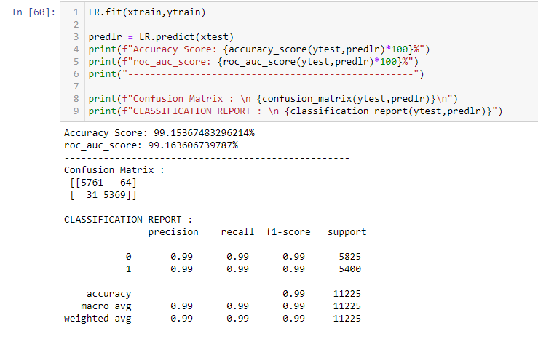
1. Logistic Regression:
Logistic Regression is giving me 99.15% accuracy.

Slide 20
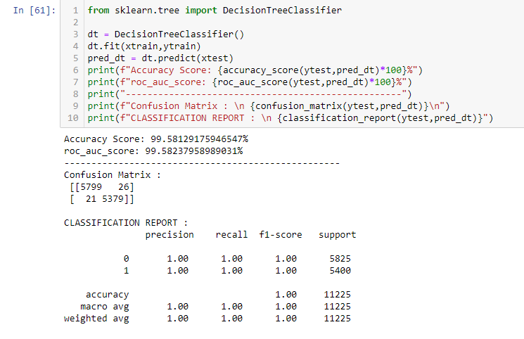
2. Decision Tree Classifier:
Decision Tree Classifier is giving me 99.58% accuracy.

Slide 21
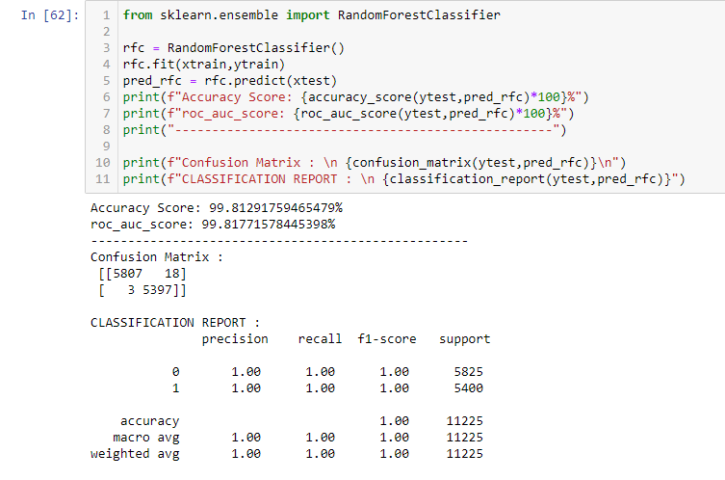
3. Random Forest Classifier:
Random Forest Classifier is giving me 99.81% accuracy.

Slide 22
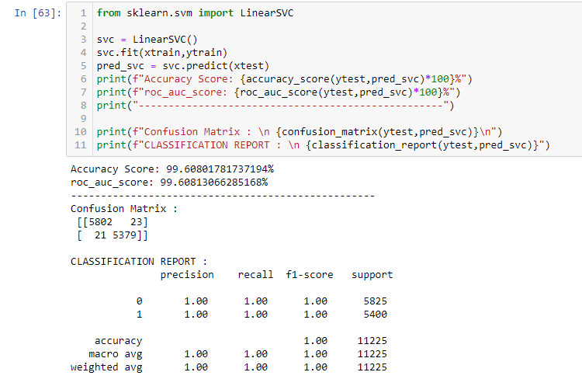
4. Linear Support Vector Machine Classifier:
Linear Support Vector Machine Classifier is giving me 99.60% accuracy.

Slide 23
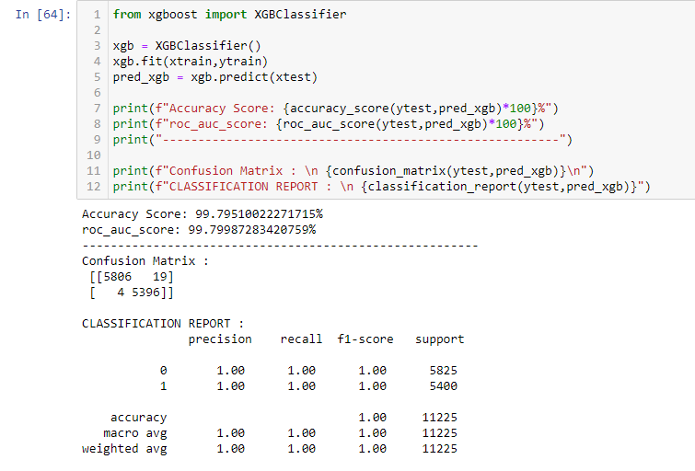
5. XGB Classifier:
XGB Classifier is giving me 99.79% accuracy.

Slide 24
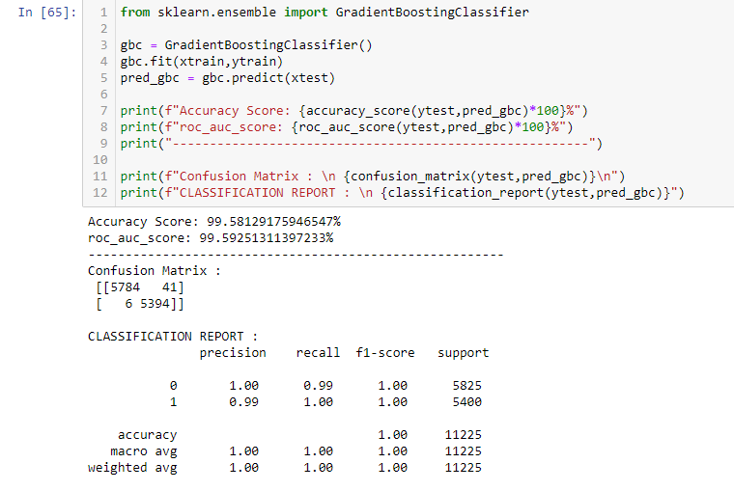
6. Gradient Boosting Classifier:
Gradient Boosting Classifier is giving me 99.58% accuracy.

Slide 25

7. Stochastic Gradient Descent Classifier:
Stochastic Gradient Descent Classifier is giving me 99.43% accuracy.

Slide 26
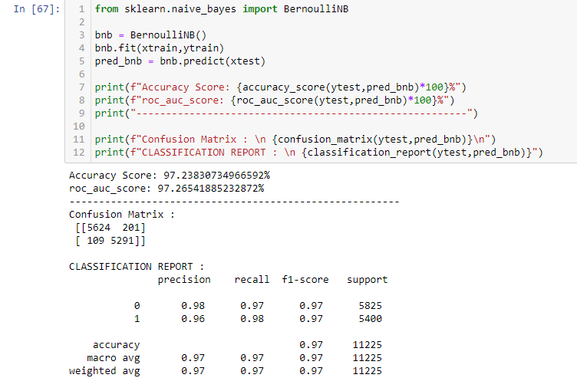
8. Bernoulli Naive Bayes Classifier:
Bernoulli Naive Bayes Classifier is giving me 97.23% accuracy.

Slide 27
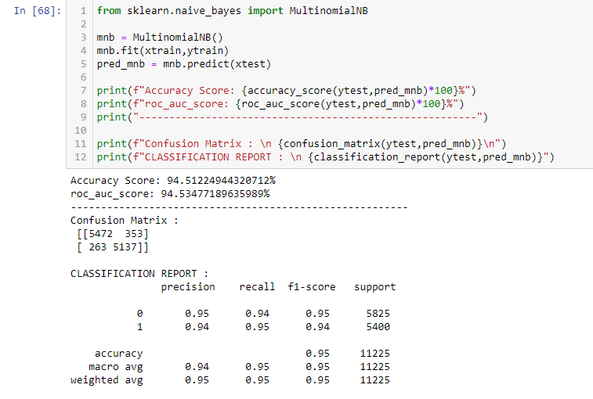
9. Multinomial Naive Bayes Classifier:
Multinomial Naive Bayes Classifier is giving me 94.51% accuracy.

Slide 28
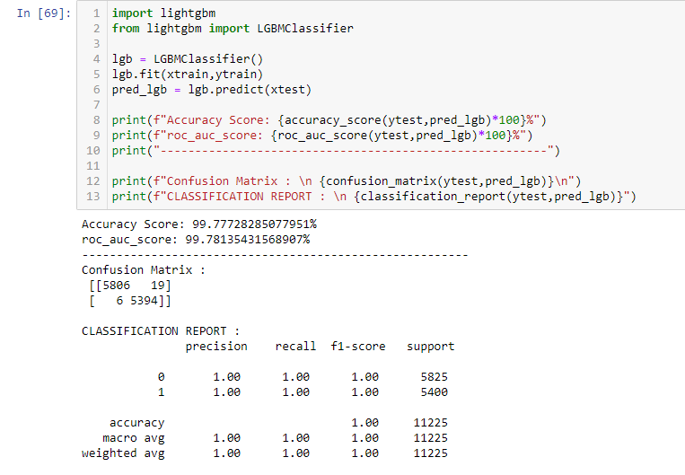
10. Light Gradient Boosting Machine Classifier:
Light Gradient Boosting Machine Classifier is giving me 99.77% accuracy.

Slide 29
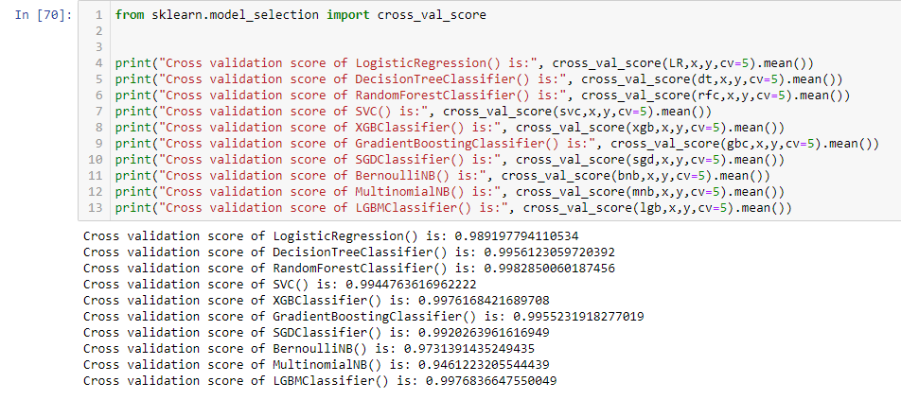
Cross Validation
As we can see, Light Gradient Boosting Machine Classifier is the best model.

Slide 30
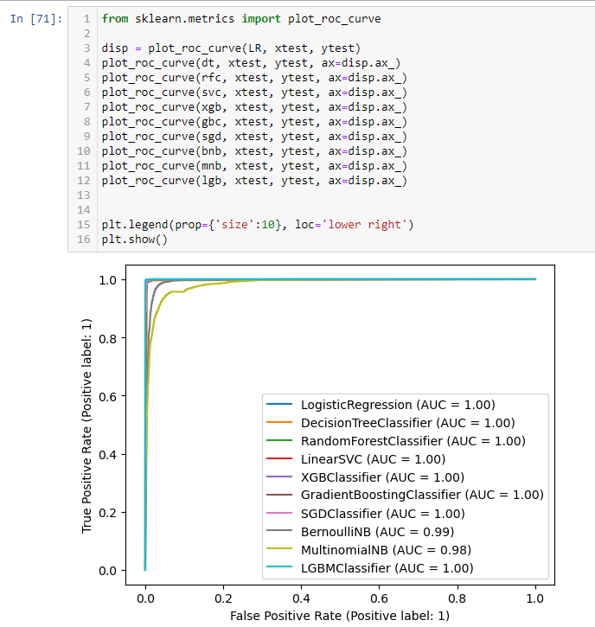
Plotting ROC-AUC curves

Slide 31
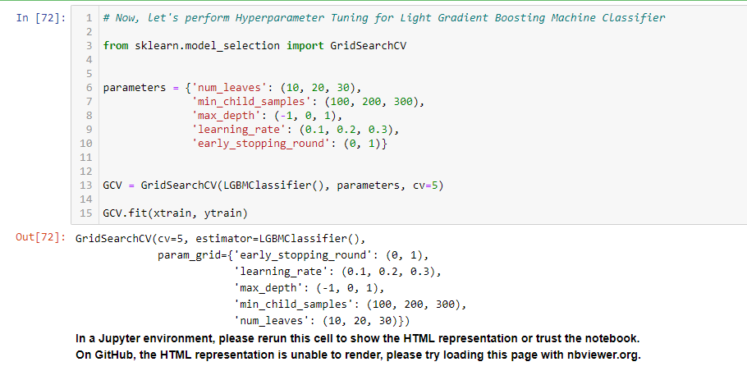
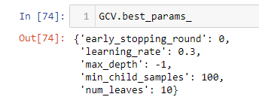
Hyperparameter Tuning

Slide 32
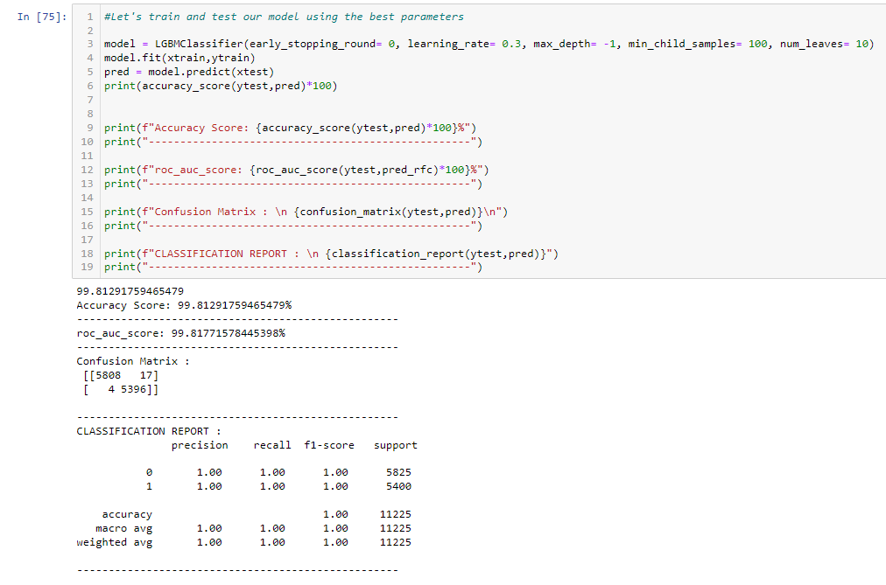
After Hyperparameter Tuning, we got an accuracy score of 99.81%.

Slide 33
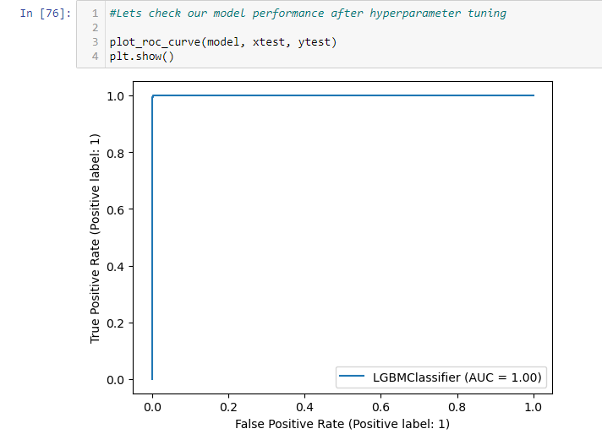
ROC curve for final model

Slide 34
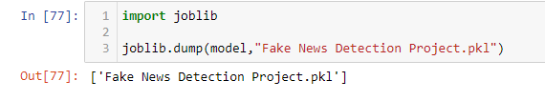
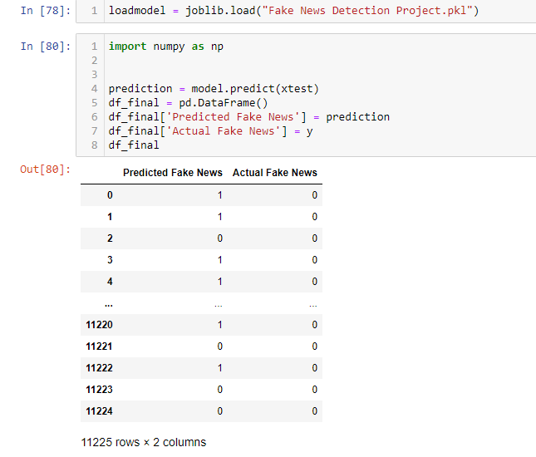
Saving the model
Loading the model

Slide 35
Converting the dataframe into CSV format and saving it

Slide 36
Conclusion:
In this project we have detected which news is fake and which news is true.
By carrying out different EDA steps, I have analyzed the text.
I have checked frequently occurring words in our data, as well as rarely occurring words.
After all these steps, I have used 10 different classification algorithms to build my model. By looking at the accuracy score and Cross Validation score, I found that Light Gradient Boosting Machine Classifier is the best model.
Then, by performing hyperparameter tuning, I got the best parameters for our final model. And finally, I got improved accuracy score for our final model.

Slide 37


